Slide 2
Monday: 8:30 a.m. – 4:30 p.m.
Tuesday: 8:30 a.m. – 4:30 p.m.
Wednesday: 8:30 a.m. – 4:30 p.m.
Thursday: 8:30 a.m. – 4:30 p.m.
Friday: 8:30 a.m. – 4:30 p.m.
Saturday: CLOSED

Slide 3
What Is the Public Workforce System?
A solution for workforce challenges
Definition
A statewide network offering employment, training, and support services to job seekers and employers.​
Purpose
To assist individuals in securing quality jobs and to help employers find and retain skilled workers.​

Slide 4
Kentucky’s Public Workforce System
Access and Entry
What is the Kentucky Career Center (KCC)?
KCC is the framework and front door to Kentucky’s public workforce system.
It connects job seekers and employers to programs and services offered by a network of partner agencies.

Slide 5
Kentucky Career Center
The Hub of the Public Workforce System
How it Works
Statewide Presence
100+ locations across all 120 counties.
Partner-Driven Model
Brings together key agencies under one system; some co-located, all connected.
One-Stop Access
Even if partners aren’t physically in a center, they are part of the system and services.

Slide 6
Kentucky’s Public Workforce System
Partners for Success
The Kentucky Career Center framework has many partners that provide no-cost workforce solutions:
Career Development Office
Office of Adult Education
Office of Employer and Apprenticeship Services
Office of Vocational Rehabilitation
Workforce Innovation Boards (WIBs)

Slide 7
Kentucky Career Center
Jobseeker Services
Ask a KCC Staff member about these services:
Career guidance and planning
Support for individuals figuring out their next step—whether that’s a first job, a new job, or a better job.
Job matching and resume help
Staff help connect job seekers to open positions and prepare them to apply.
GED and foundational education
Adult Education can help individuals complete high school equivalency or build skills needed for training and employment.
Skill-building opportunities
Job seekers may be eligible for training or apprenticeships that build workforce-ready skills.
Support to stay employed
Transportation help, work gear, and other resources can reduce barriers to staying on the job.

Slide 8
The Kentucky Career Center
Find Your Next Job — Fast!
Hiring Events and Job Fairs
Meet employers ready to hire now Learn about job openings in your area Interview on the spot — no waiting weeks Get face time with multiple companies in one place Prepare with help from a Career Coach before the event
Ask about upcoming hiring events — or visit kcc.ky.gov to learn more.

Slide 9
Veterans: Your Service Matters – So Does Your Career
You served your country. Let us help with what’s next.
Translate your military experience into a civilian career
Build a powerful resume using your service background
Explore veteran hiring programs and benefits
Attend job fairs and hiring events tailored for veterans
Talk to a Career Coach who understands veterans' needs

Slide 10
Laid Off? We’ve Got Your Back.
Been laid off? Don’t start over alone.
Find new job opportunities fast Get help with resume updates and applications Learn about unemployment insurance and training options Access hiring events and career workshops
A Career Coach can guide you through every step.
Visit kcc.ky.gov or ask at the front desk to connect.

Slide 11
Looking for a Job? Start with the Career Center.
Let’s make a plan together.
Find job openings that match your goals Improve your resume and interview skills Learn how to stand out in today’s job market Explore training and upskilling programs
Career Coaches are here to help — at no cost to you.

Slide 12
What Can a Career Coach Help You With?
Not sure what’s next? Ask a Career Coach.
Struggling to land interviews? Don’t know what jobs fit your skills? Overwhelmed by applications and paperwork? Wondering about training or certifications?
Career Coaches help you break down barriers and create a plan.

Slide 13
Meet Your Career Coach
Real people. Real support. Real results.
Personalized career planning
Resume, application & interview help
Info on local jobs, training & events
Guidance for veterans, young adults, and more
Connect today — just ask to speak with a Career Coach.

Slide 14
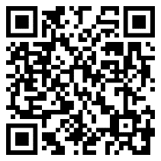
Your Journey Starts Here
Earn Your GED. Learn English. Get Job-Ready.
Free adult education in all 120 Kentucky counties
GED® prep
ESL classes & college readiness
Family literacy & job-focused training
Learn at your pace, in your community
Visit your local Kentucky Adult Education center today — take the first step to a better future.
SCAN ME
TO LEARN MORE

Slide 15
Build Skills That Work for You
From training to college prep — we’ve got your back
Workforce certifications & job training
Transition support to college or career programs
English as a Second Language (ESL) & family literacy
Programs for reentry & second chances
Visit your local Kentucky Adult Education center today — take the first step to a better future.

Slide 16
Real Skills. Real Results.
Boost Your Skills — Open Career Doors
Visit your local Kentucky Adult Education center today — take the first step to a better future.
SCAN ME
TO LEARN MORE

Slide 17
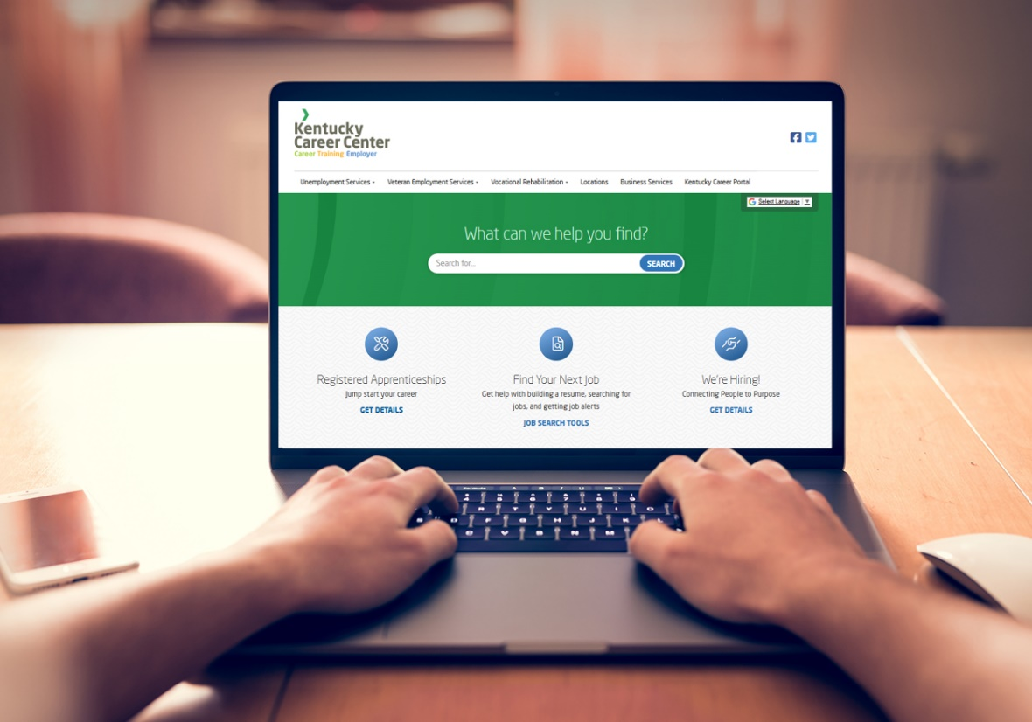
Recently Laid off? Looking for a New Job?
The Kentucky Career Center can help you with job searches, resume and cover letter assistance, job fairs and hiring events, and military veteran employment services.
Visit kcc.ky.gov to get started.

Slide 18
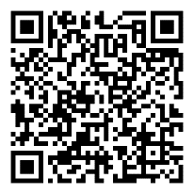
Get Your GED® for FREE in Kentucky!!
What’s covered: ✅ Your first test in each subject ✅ 2 free retakes per subject (in person) ✅ 1 free retake per subject (online)* While funding lasts
Step 1: Take the Free GED Ready® Practice Test Available at any Kentucky Adult Education Center
Step 2: Schedule Your Test
Find your local KY Adult Education center to get started!
SCAN QR CODE
TO LEARN MORE

Slide 19
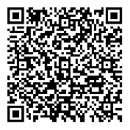
The Kentucky Office of Vocational Rehabilitation assists Kentuckians with disabilities to achieve suitable employment and independence. The office employs counselors in over 50 offices covering all 120 counties in Kentucky. Call (800) 372-7172 (Voice) or 502-542-6042 (P3) for more information.
​
The Office may provide vocational rehabilitation services needed to reach your vocational goal. Some examples are as follows:
Assessment for determining eligibility and vocational rehabilitation needs
Counseling and guidance
Physical and mental restoration
Personal skill development
Vocational and other training services
Supported employment
Personal assistance services
Low-vision aids
Interpreter and notetaking services
Rehabilitation technology and equipment training
Job placement and job retention services
On-the-job training
Employment follow-up and post-employment services
Information and Referral
Pre-Employment Transition Services
SCAN ME
TO LEARN MORE

Slide 20
Your Ability is Your Strength
Have a disability? We’re here to help you find meaningful work.
One-on-one support from a trained vocational counselor
Help with skills, training, and job placement
Services for physical, mental, or sensory disabilities
Support that continues after you start working
Contact the Office of Vocational Rehabilitation to get started
📞 (800) 372-7172 | 📱 502-542-6042 (P3)

Slide 21
Jumpstart Your Career with Ready for Industry®
Not sure where to start? Explore industries. Gain skills. Get job-ready.
15–20 hours of free, online, self-paced learning
Learn about Manufacturing, Healthcare, IT, Logistics, Construction
Covers real-world topics:
Workplace practices
Industry terms
Career paths & certifications
Prepares you for job interviews and day-one success
Register at kcc.ky.gov or visit your local Kentucky Career Center.

Slide 22
From Learning to Earning:
Be Ready on Day One
Be the candidate employers want to hire.
Learn about Manufacturing, Healthcare, IT, Logistics, Construction
Understand your chosen industry before your first day
Learn:
Workplace expectations
Current industry trends
Basic safety, privacy, and security practices
Receive support through Kentucky Career Centers
Optional certification from NOCTI gives you a competitive edge
Register at kcc.ky.gov or visit your local Kentucky Career Center.

Slide 23
You have served us. Now let us serve you.
We thank you for your service and offer a range of supports for veterans. Kentucky Career Centers, staffed by trained veterans, are here to help you transition to meaningful civilian employment.
Available Services
​Priority of service
Career assessments
Job search assistance
Interview preparation
Labor market information
Resume and cover letter assistance
Access to computers and internet service
Translating military experience to civilian responsibilities
Specialized services for veterans with disabilities through our Office of Vocational Rehabilitation
If you have questions or require additional information, please email veteranservices@ky.gov​

Slide 25
Your Next Job Starts with WIN
Train. Test. Get Hired.
What is WIN?
Industry-recognized credentials
Learn workplace etiquette & teamwork
Gain confidence with real-world problem solving
WIN is used by KY State Police, Hitachi, and more
Boost your resume — stand out to employers!
WIN Career Readiness is an online program that helps you build the foundational skills employers look for most — like problem solving, teamwork, and workplace communication.
It includes career exploration tools and real-world scenarios to help you prepare for success on the job.
Completing the program can lead to a nationally recognized credential that shows you're ready for work.
Ask a staff member about WIN Career Readiness today!

Slide 26
Get Ready for the Job You Want!
Build the Skills Employers Want — with WIN
Free career readiness training for all Kentucky adults
Learn at your pace: Online modules + real credentials
Improve your math, reading, digital, and soft skills
Get help from Career Coaches at your local center
WIN works — for job seekers, employers, and YOU!
Ask a staff member about WIN Career Readiness today!

Slide 27
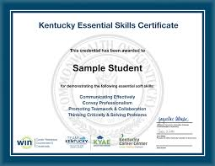
Earn the Kentucky Essential Skills Credential
Show Employers You’re Work-Ready
Master the soft skills employers ask for most
Learn teamwork, communication, and professionalism
Recognized by employers across Kentucky
Signed by the Lt. Governor!
Quick, flexible online training — at no cost to you
A powerful credential to add to your resume!
Ask a staff member about WIN Career Readiness today!

Slide 28
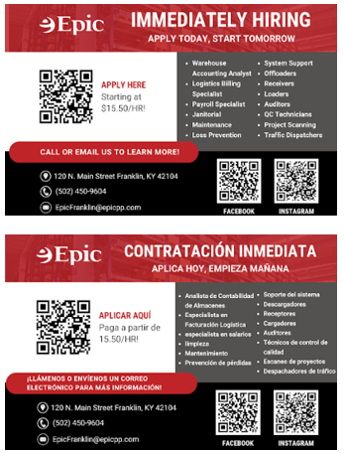
Upcoming Career Fairs

Slide 29
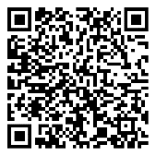
The Kentucky Career Center’s Office of Employer and Apprenticeship Services is the state’s approving agency for the Registered Apprenticeship Program.
The program helps businesses improve workforce development by increasing retention and filling hard-to-fill jobs through work-based training. With over 1,500 apprenticeships, including non-traditional roles, it offers an alternative path to education, supporting Kentucky’s growth.
Contact Apprenticeship@ky.gov.
SCAN ME
TO LEARN MORE

Slide 30
Registered Apprenticeship
On-the-Job Training
What is registered apprenticeship?
A Registered Apprenticeship is an officially recognized education and training model endorsed by the federal Department of Labor.
It is a way for new and current employees to receive high-quality training that is aligned with industry standards.
National Certification
Related Technical Instruction
Components of
Registered Apprenticeship
Wage Progression
Mentorship
Ask a Career Coach about Registered Apprenticeships or email Apprenticeship@ky.gov

Slide 31
Earn While You Learn
Registered Apprenticeship
Build a career. Get paid while you train.
Learn hands-on in the field — no student debt
Choose from over 1,500 apprenticeship programs across Kentucky
Opportunities in healthcare, IT, skilled trades, and many more!
Gain real experience and a nationally recognized credential
Ask a Career Coach about Registered Apprenticeships or email Apprenticeship@ky.gov

Slide 32
Registered Apprenticeship
What It Really Means to Be a Registered Apprentice
You are in a formal training program recognized by the U.S. Department of Labor
You are an employee learning your occupation through real work experience
You are working toward becoming a Journeyworker — a fully qualified professional in your industry
You are gaining both practical skills (OJT) and educational knowledge (RTI)
You are part of a career pathway, not just a job
You are earning wages while building long-term credentials
Ask a Career Coach about Registered Apprenticeships or email Apprenticeship@ky.gov

Slide 33
How To Become Job-Ready Starting Today
Learn in-demand, job-ready skills with Coursera
Gain the skills and real-world experience to be a great job candidate.
Complete hands-on Guided Projects and world-class courses to quickly learn everything from interview and communication skills to Microsoft Excel for business.
Join 97M+ global learners on Coursera and choose from more than 5,000 world-class courses as you prepare for career success in today's job market.
Sign up for Coursera and start learning today!
To get started, create an account with the invitation link sent by your career coach via email.
Get started with these popular options:
How to build a Professional Resume
Excel in a job interview
Microsoft 365 Fundamentals
Writing professional emails and memos
Facebook Marketing Analyst

Slide 34
Reemployment Services and Eligibility Assessment (RESEA)
The Reemployment Services and Eligibility Assessment (RESEA) program is a reemployment services program for profiled unemployment compensation (UC) claimants.
RESEA primarily serves two populations:
Individuals who are profiled as most likely to exhaust benefits
Unemployment Compensation for Ex-servicemembers (UCX) Recipients
Only claimants who have received at least one UC payment are eligible for profiling and selection. Selected claimants are then required to participate in RESEA to continue receiving UC which includes intensive case management through:
A Welcome and Orientation to the KCC and the RESEA Program
The submission of an initial assessment and completion of an IEP with a career coach
Required appointments with the career coach/reporting to reemployment services, as necessary
To learn more, contact your career coach.

